Slide 1

Databrary
A research-centered repository for video data
Andrew Gordon
Information Engineer
New York University

Slide 2

Intended Community
Developmental and learning sciences
Researchers who use video to study human behavior

Slide 3
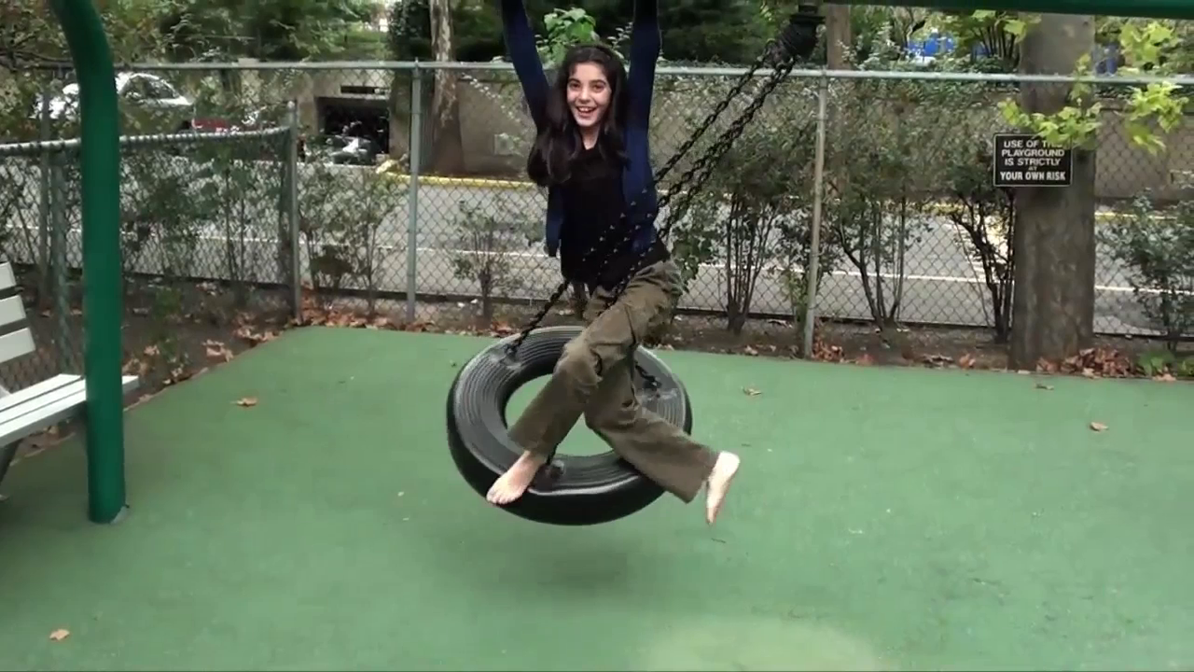
Video as Data
Notes:
The purpose of this repository is specifically aimed at sharing and reuse of video data
Video data are rich sources of information, which can be interpreted in many different ways
This is a video typical of a motor development researcher, children navigating an environment at different ages

Slide 4
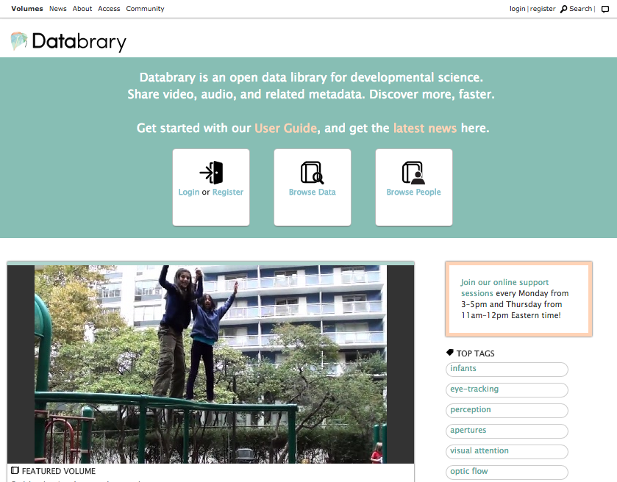
Notes:
This is the front page to give you an idea of what it looks like.
Making the data available and accessible right in the browser.
Following best practices for user experience and web design

Slide 5
Some Background
Funded for open sharing and reuse of video data by NIH and NSF
Hosted by Steinhardt School at NYU with help from NYU Libraries and ITS
Started early 2013, opened for general use October 2014
Notes:
Also support from The Pennsylvania State University

Slide 6

Contribution Statistics
Successful growth of community
As of May 2015:
8200 video files
2700 hours of video
2400 records of 2100 participants
35 contributors, 121 authorized users
69 institutions world-wide
Notes:
Successful growth over less than a year.

Slide 7
A Caveat (or two)
Focus on research practices and how to encourage more data contributions
Not designed to be a turnkey system (yet)

Slide 8
Challenge - Ethics
Ethical obligations for research with human participants
Many stakeholders involved
Notes:
These data are subject to many access restrictions, high disclosure risk and privacy concerns
IRB, Participants, Funders involved in the process

Slide 9
Solution - Ethics
Cohesive, standard policies for sharing and reusing data
Documentation and template language
Let researchers start with sharing in mind
Notes:
A novel challenge with a novel solution
Most important first step was the right policies
With the help of NYU General Counsel and our IRB
Access Agreement and template languages for Data management plans in communicating with funders, langauge for approaching IRB, participant consent forms help researchers
So they can begin their studies cleared for sharing and reuse

Slide 10




Access Restrictions
Release Levels
Private: This content has not been shared and is restricted to collaborators
Authorized Users: This content is restricted to authorized Databrary users
Excerpts: This content is restricted to authorized Databrary users, who may use it in presentations for informational or educational purposes
Public: This content is available openly to anyone
Notes:
4 release levels that apply to sessions and individual files
Allow researchers to fine tune who can access their data

Slide 11
Challenge - Supporting Community
Data management for diverse datasets
Meet researchers where they work
Make sharing easy
Notes:
Heterogeneous lab practices make for very different variables and file organization between contributors
Need to support the work they already do, or they won’t use it
And it all has to fade into the background and not be too much additional work

Slide 12
Solution - Supporting Community
New expectations
Cultural shift
Staff work directly with researchers and their IRBs
Notes:
….
Providing one-on-one support and assistance at any stage
Regular online support hours
Regular outreach and workshops at national conferences to engage researchers and get them on board

Slide 13
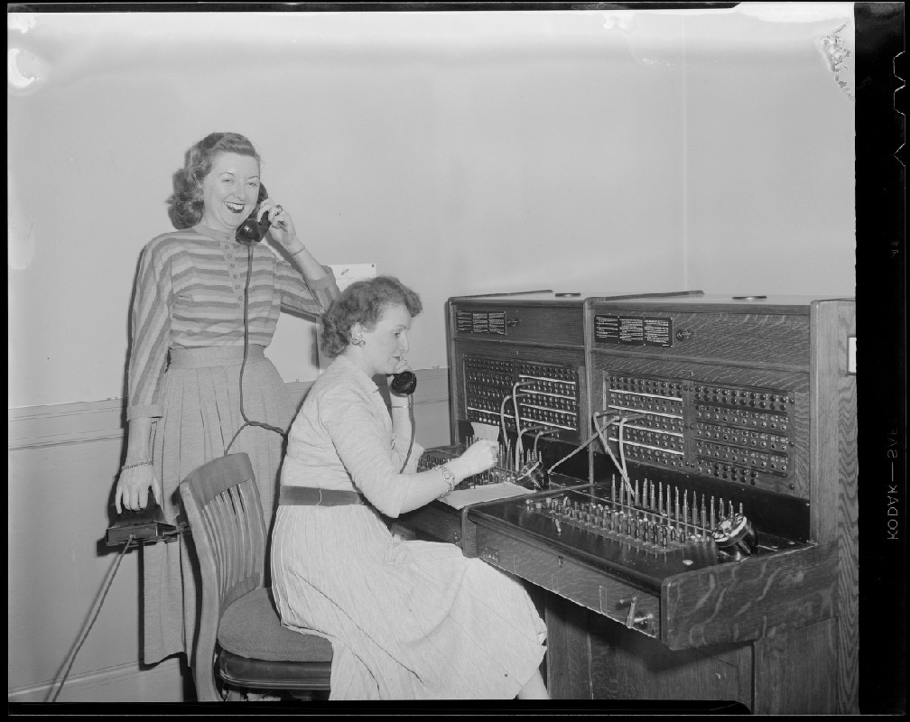
Image Source: http://ark.digitalcommonwealth.org/ark:/50959/nz8061582 Copyright (c) Leslie Jones.
Notes:
Effectively, operators are standing by.

Slide 14
Challenge - Data Curation
Curating data is labor intensive
Researchers have limited time and resources
Notes:
Video data are information rich, but not self-describing
Researchers will not spend extra time preparing data for a repository unless they have to, want to move onto the next project

Slide 15

Image source: https://www.flickr.com/photos/kk/18768224
Notes:
Data can be on paper, filed away or stored idiosyncratically (as with consent forms, data intake sheets)

Slide 16
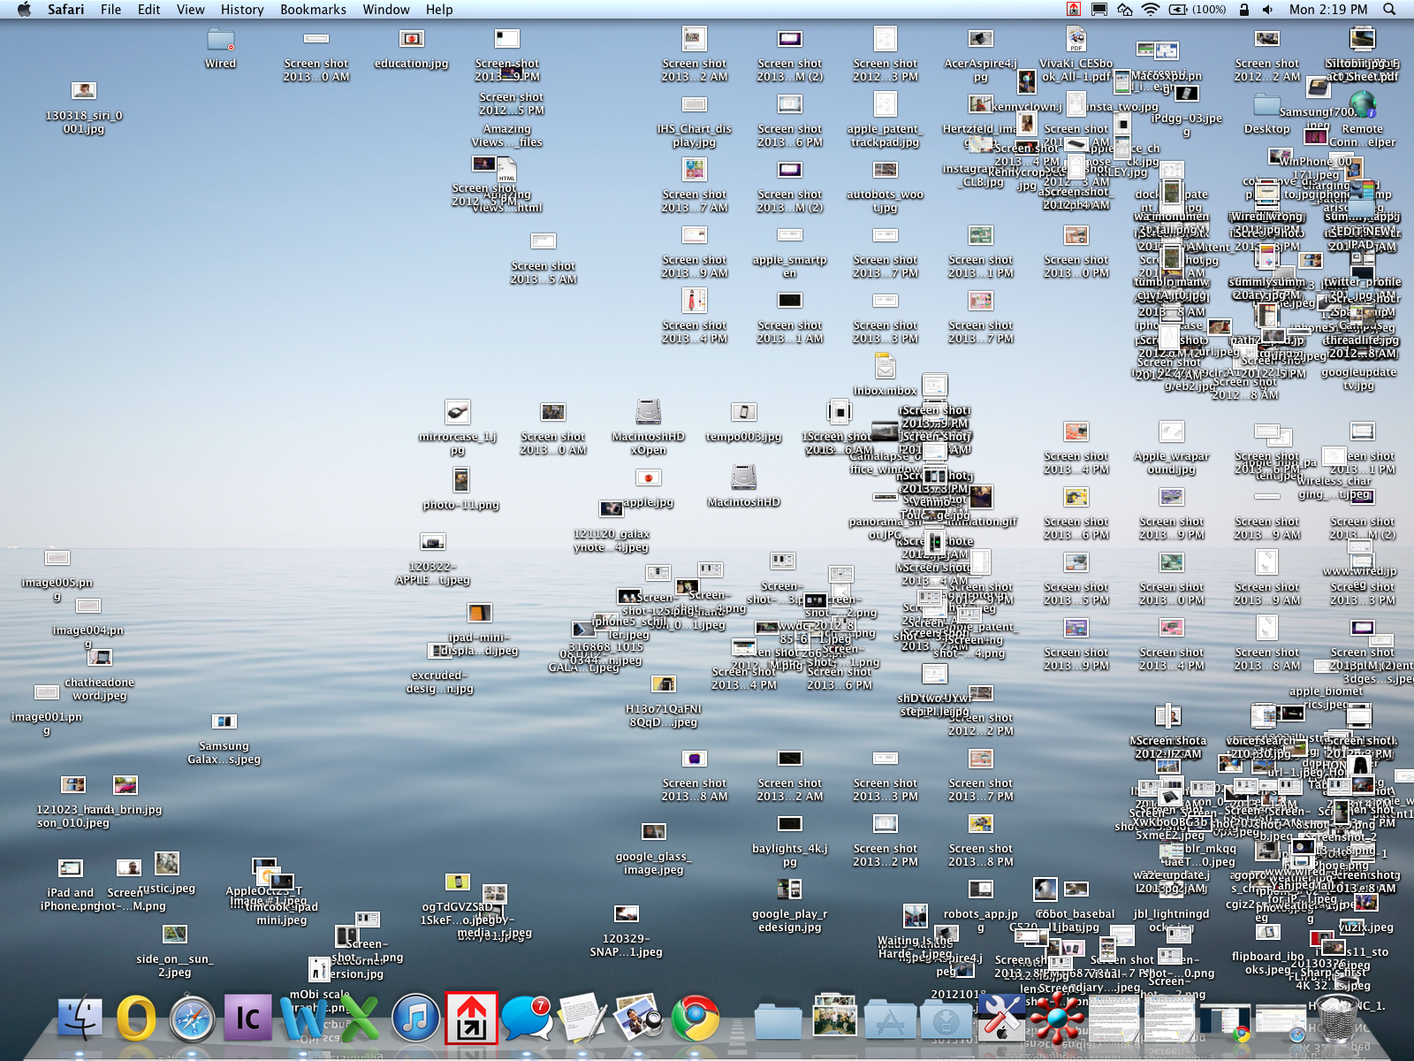
Image source: http://www.wired.com/images_blogs/gadgetlab/2013/04/Messy_desktop.png
Notes:
Born digital materials may also be organized in lab specific ways, have to get information about expected relationship between files and between files and metadata

Slide 17
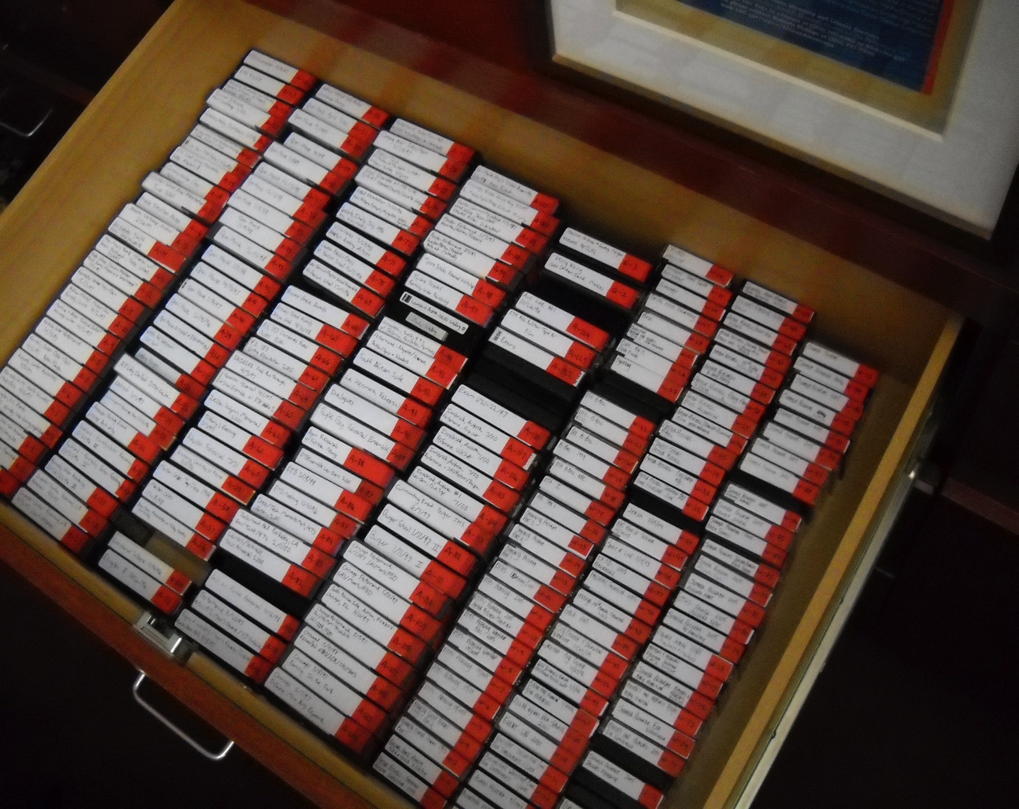
Image source: https://preservingdtharchives2011.files.wordpress.com/2011/08/dscn0807.jpg
Notes:
Sometimes video data are still on camcorder tapes, have to be digitized
Labels have to be interpreted, sometimes they fall off.

Slide 18
Solution - Data Curation
Post hoc curation
Capturing and standardizing metadata
Obtaining consents on older datasets
Standardized ingest workflows
Notes:
Doesn’t always work

Slide 19
Solution - Data Curation
Self-curation
Online tools to support researcher curation at source
Fits to common researcher practices

Slide 20
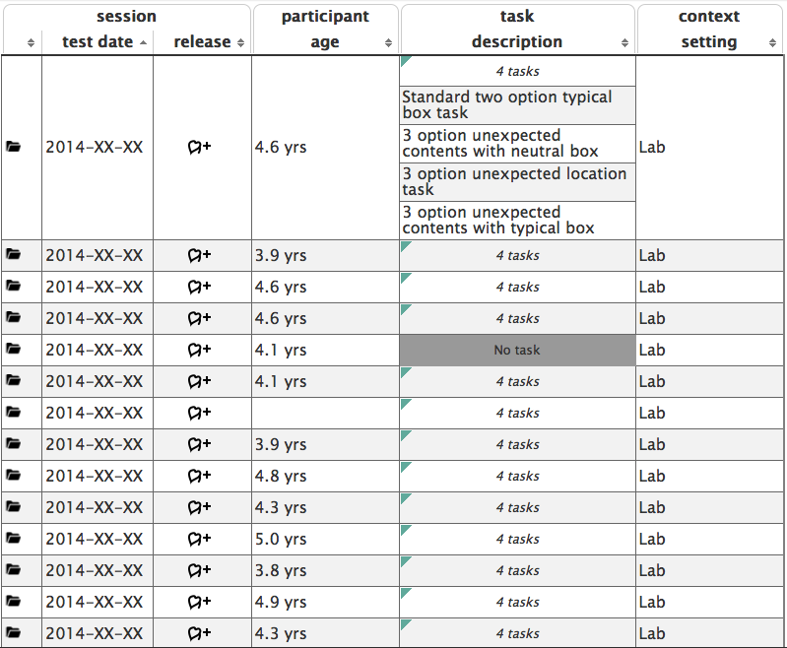
Spreadsheet
https://nyu.databrary.org/volume/98
Notes:
General view for seeing, editing, and adding session level metadata
We observed that researchers make frequent use of spreadsheets in data management. Wanted to stick to that to make this tool more transparent

Slide 21
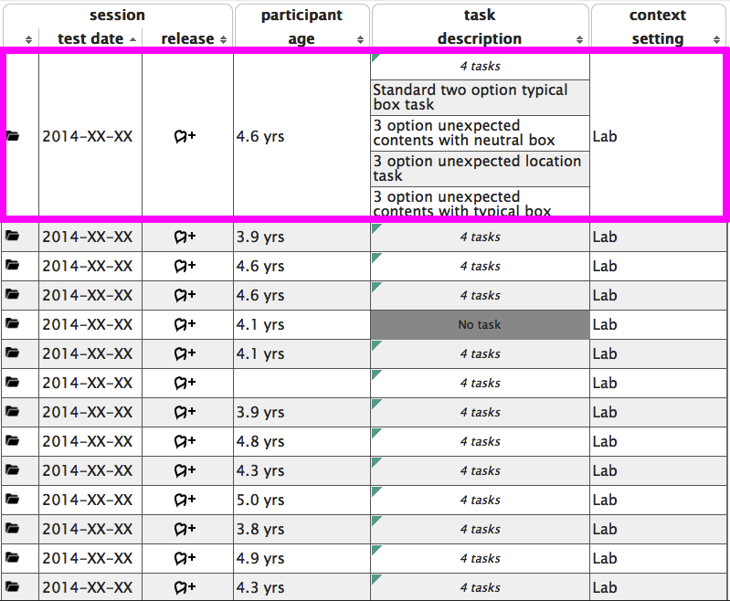
Spreadsheet
https://nyu.databrary.org/volume/98
Notes:
Rows are individual sessions

Slide 22
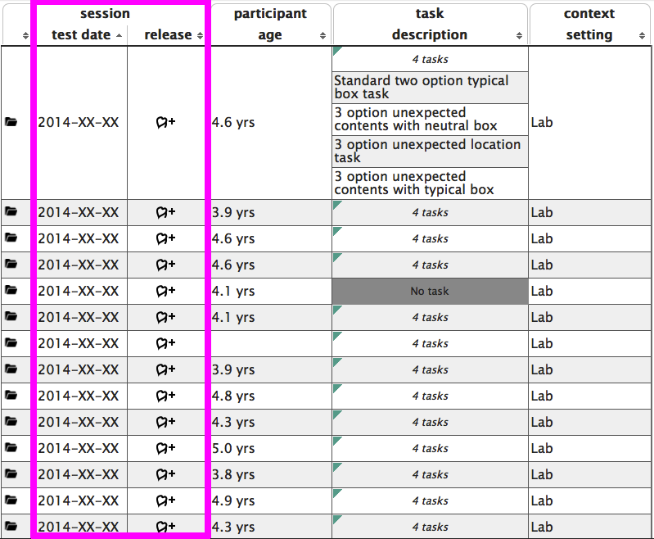
Spreadsheet
https://nyu.databrary.org/volume/98
Notes:
When sessions took place and who can access and how

Slide 23
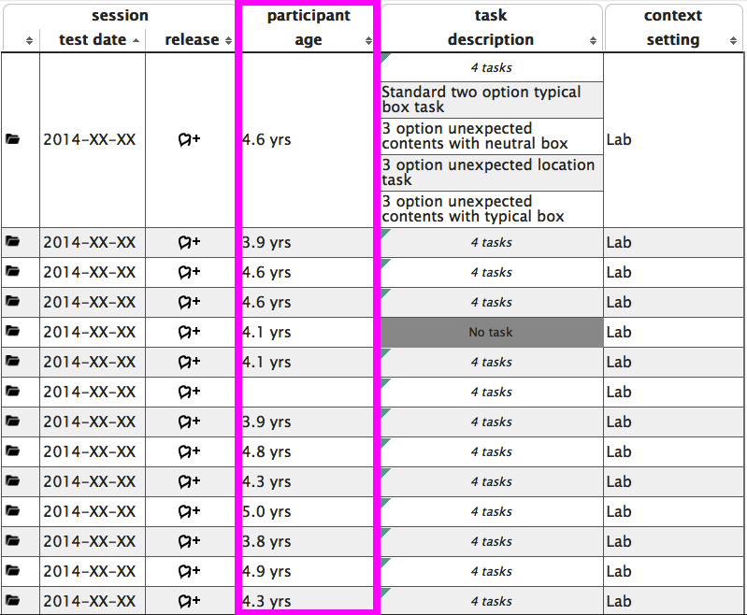
Spreadsheet
https://nyu.databrary.org/volume/98
Notes:
This information is redacted, users that have access to this dataset would be able to see the full set of participant metadata

Slide 24
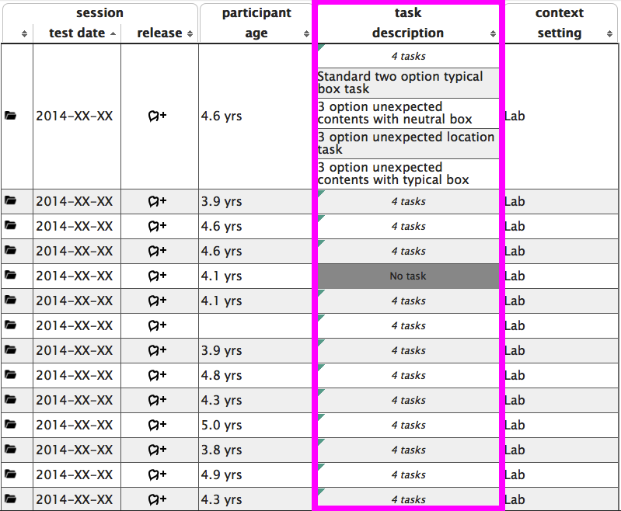
Spreadsheet
https://nyu.databrary.org/volume/98
Notes:
Expanded here are tasks, the behavior of interest in a study

Slide 25
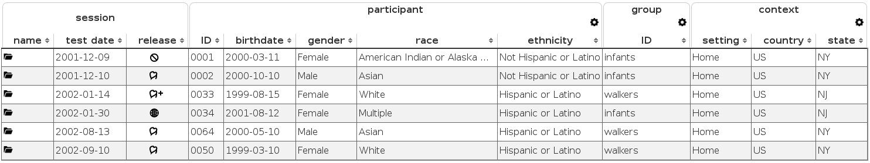
Spreadsheet
(with made-up data)
Notes:
These are completely made up data to show that the spreadsheet is fungible and what a full set of metadata might look like

Slide 26
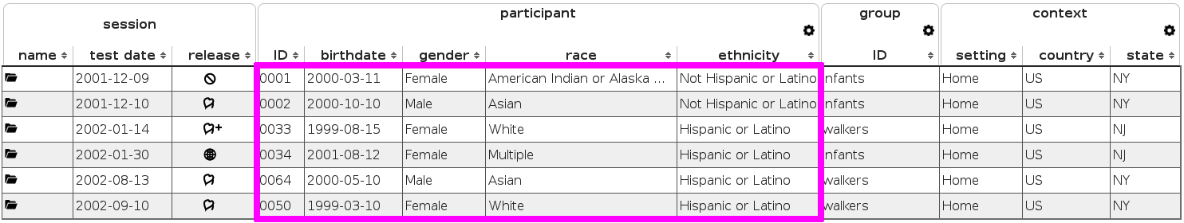
Spreadsheet
(with made-up data)
Notes:
The participants here have been expanded

Slide 27
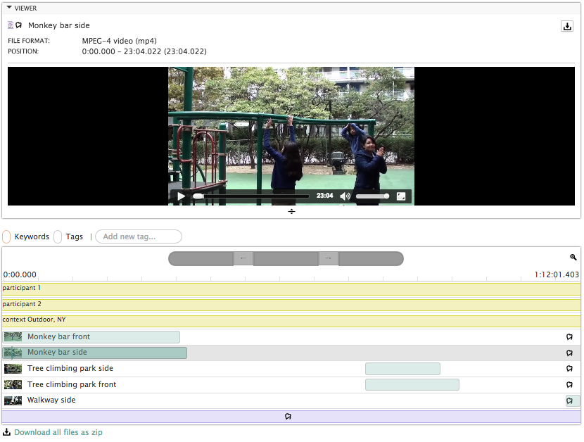
Timeline
https://nyu.databrary.org/volume/9/slot/6113?segment=-&asset=9609
Notes:
Timeline built from seeing how researchers in this area make frequent use of desktop video coding software to tag and annotate videos for events, themes and behaviors
Position files and metadate for when they occur – again a component of data management and not just storage.

Slide 28
Challenge - Infrastructure
Video data are large, difficult to share and store
Standardize storage and access of video data and metadata
Notes:
Difficult and expensive to store
We also needed a backend to standardize file formats and metadata schemas that are coming from many different labs.

Slide 29
Solution - Infrastructure
Dataset designed to map to research study
Components of datasets mapped to how researchers organize their data
Minimal metadata for maximum contributions
Notes:
Create a design on the backend that allows us to reflect how researchers see their own data.
Datasets are studies. Components of studies map to how researchers already organize their data
Observed a sampling of labs, but process is iterative, we learn more as we get more datasets
Minimal requirements for metadata such that the data are understandable by other researchers and searchable

Slide 30
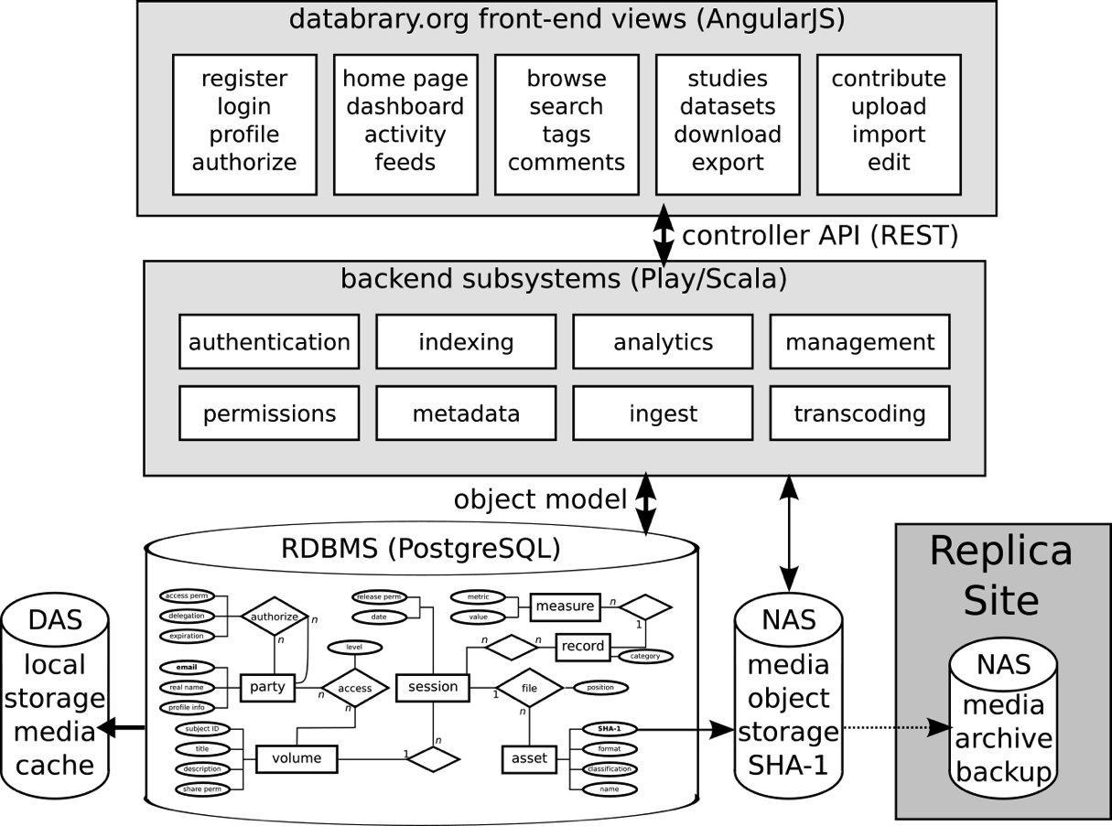
Technology Stack
Source code: https://github.com/databrary/databrary

Slide 31
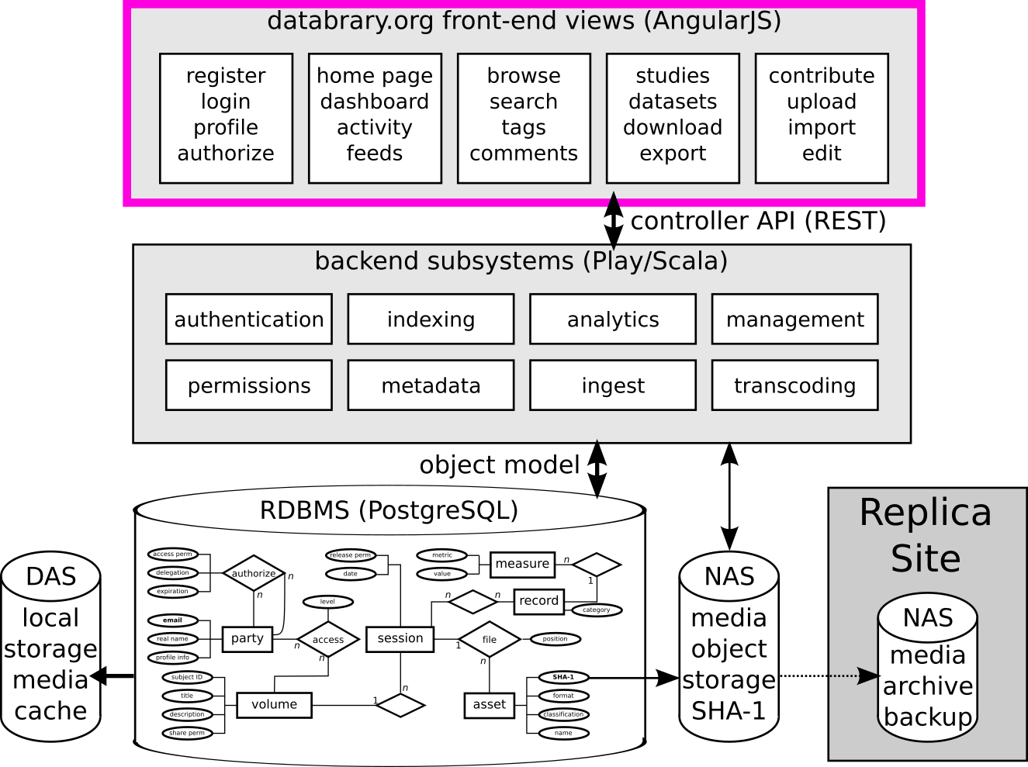
Technology Stack
Source code: https://github.com/databrary/databrary
Notes:
Made to be accessible and user friendly
AngularJS for responsive, dynamic client side

Slide 32
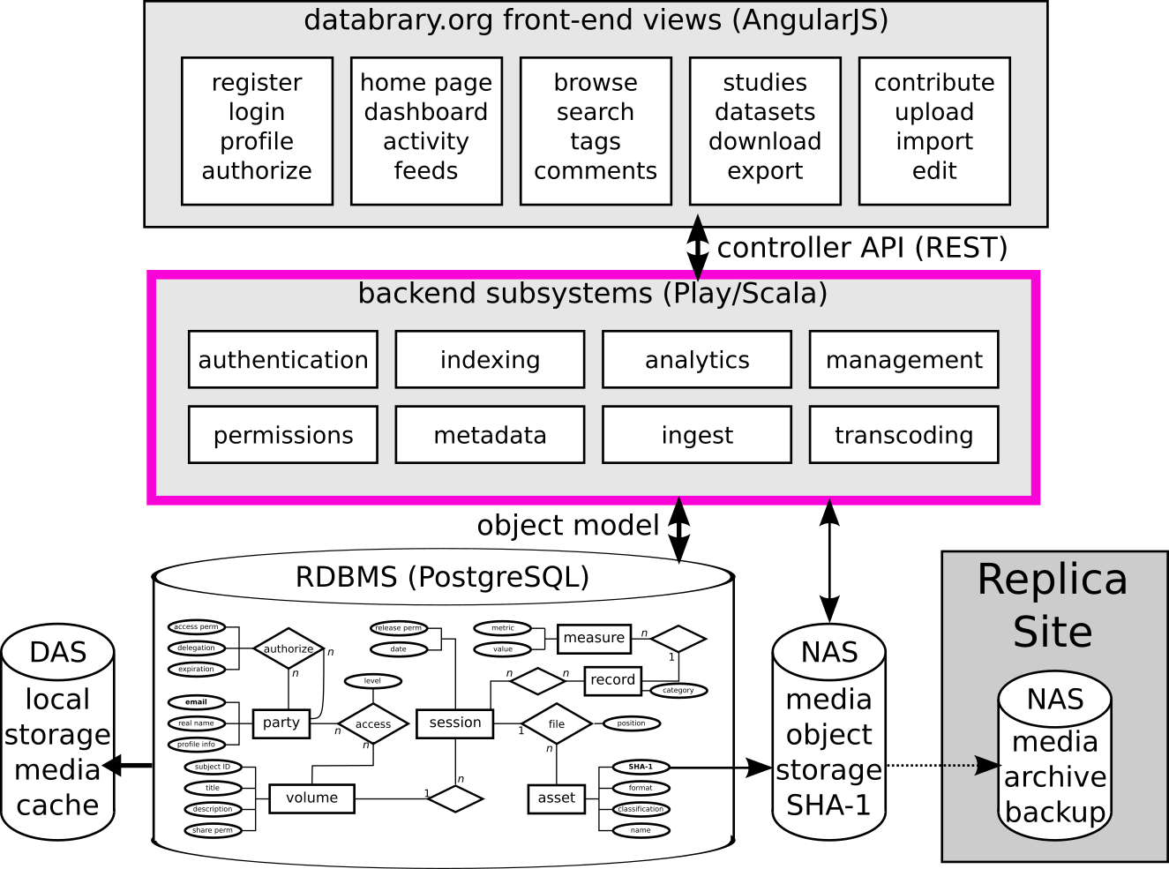
Technology Stack
Source code: https://github.com/databrary/databrary
Notes:
Play Framework on Scala provides routing data between database and user
JSON API
Site authentication and basic application logic

Slide 33
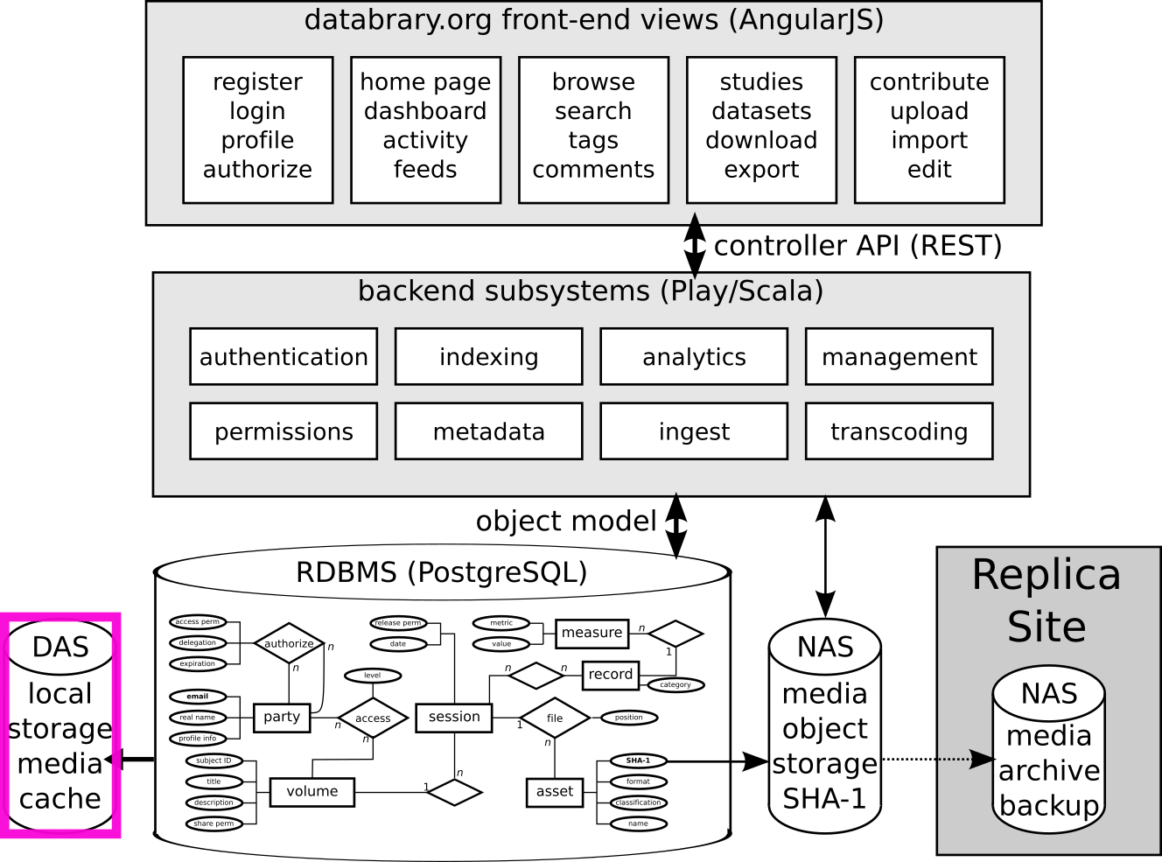
Technology Stack
Source code: https://github.com/databrary/databrary
Notes:
Direct attached storage for caching

Slide 34
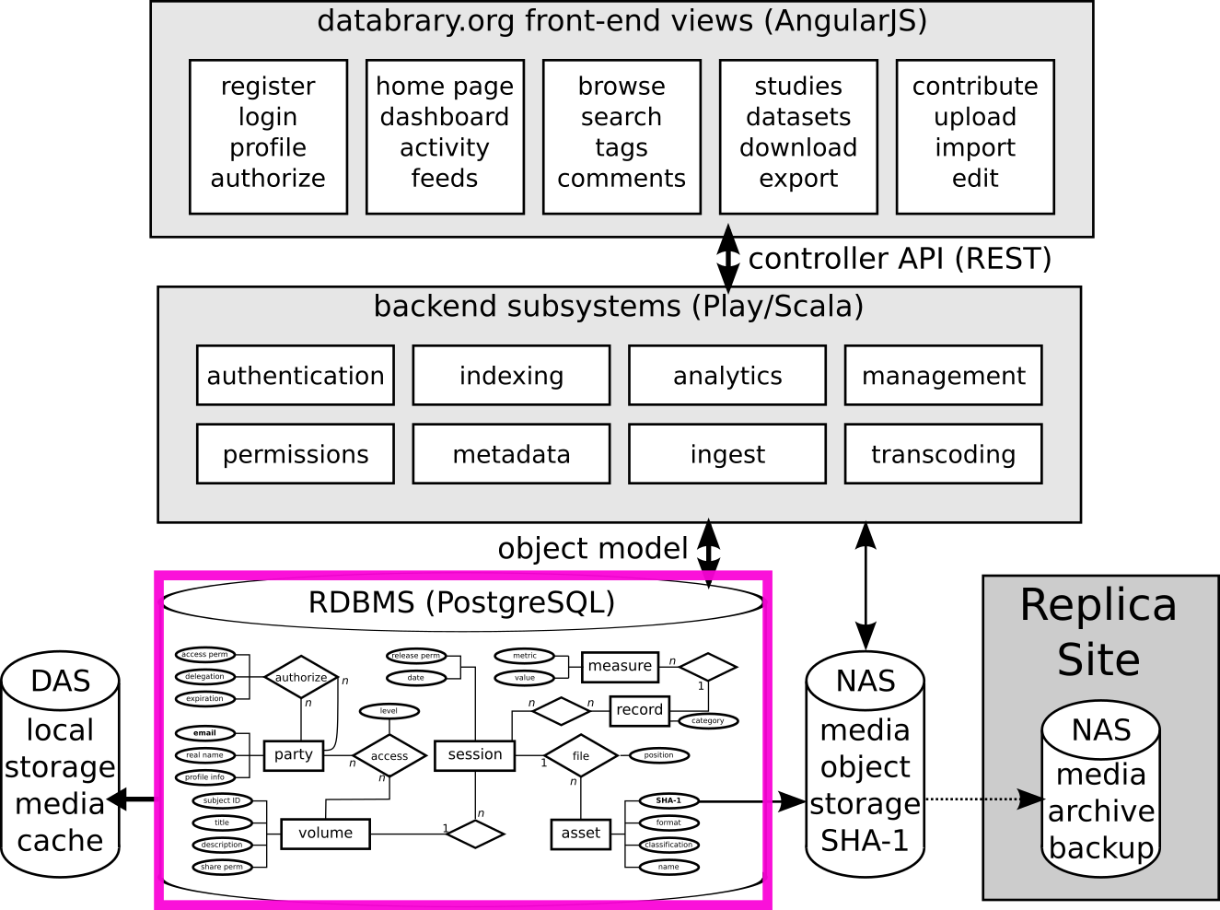
Technology Stack
Source code: https://github.com/databrary/databrary
Notes:
On production server in NYU data center
Stores metadata
Handles some indexing

Slide 35
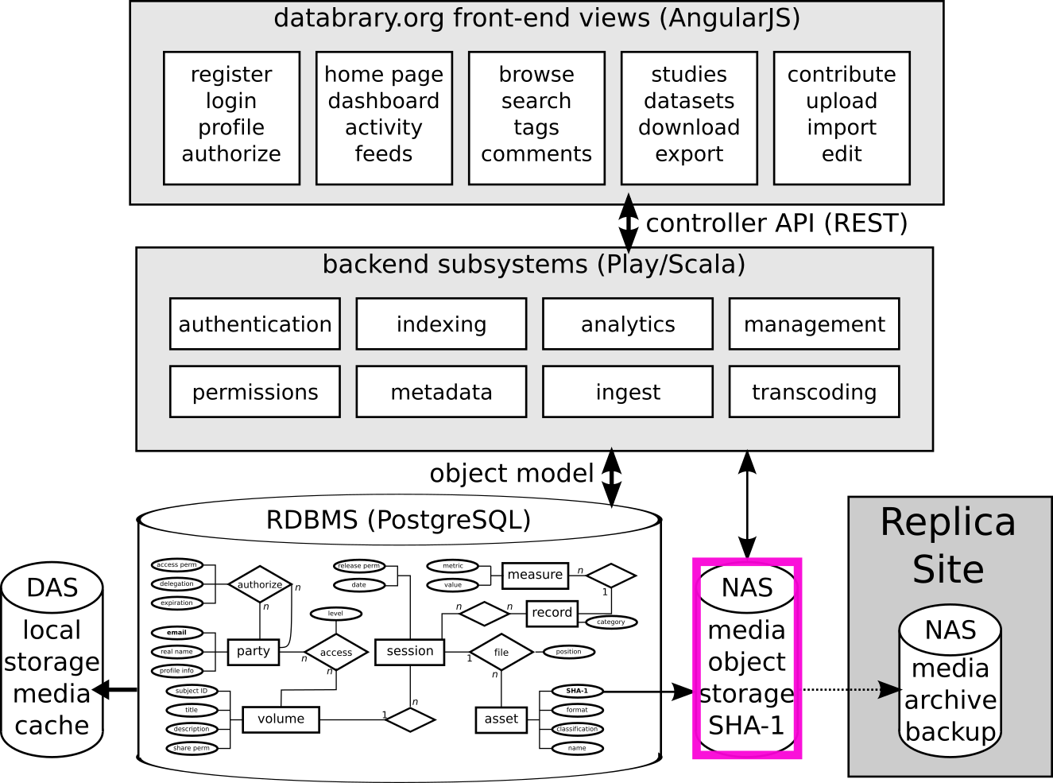
Technology Stack
Source code: https://github.com/databrary/databrary
Notes:
Network Attached Storage in NYU Data Centers
Fixity checks
METS metadata
Migration plan
Indefinite storage

Slide 36
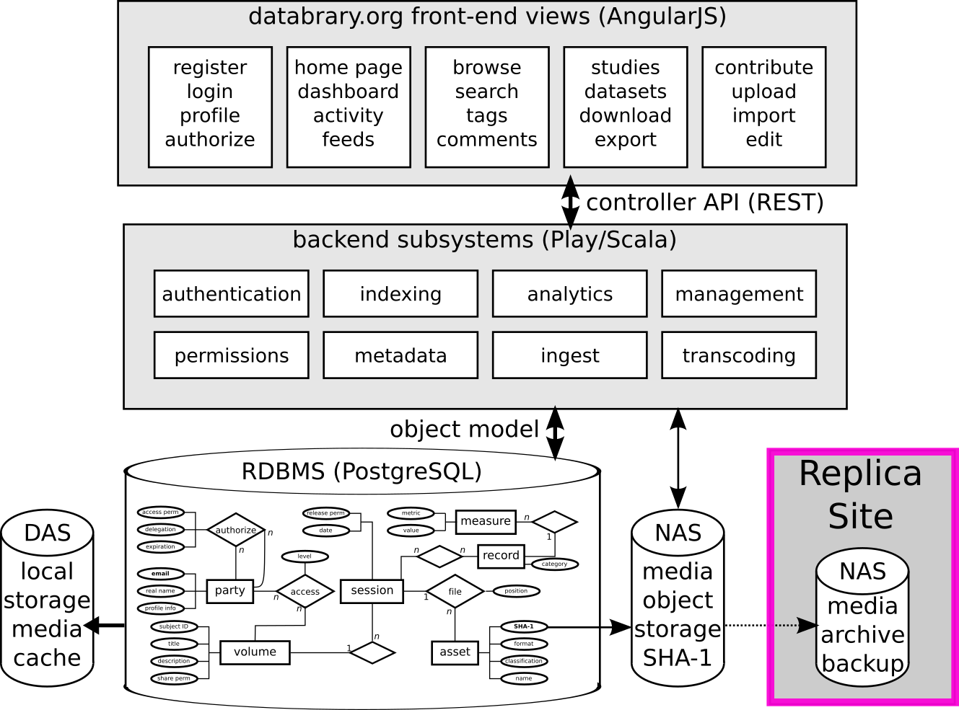
Technology Stack
Source code: https://github.com/databrary/databrary
Notes:
Mirrored upstate NY
Regular back up to tape

Slide 37
Future Directions - Near term
More refined and faceted search
Provide DOIs for datasets
Support more diverse file formats
Regional workshops
Notes:
Search improvements to help researchers drill down to the segment level in a video file to find what they need
DOIs allow for easy citation in future papers as well as a place for measuring the impact of reused data in future publications
Want to support more of the files and data that researchers use in their work
Regional work shops bring Databrary to researchers where they can learn more about it and how to get started.

Slide 38
Future Directions - Long Term
Provide more support for existing research workflows online
More interoperability with discovery systems
Notes:
Allow researchers to do more of their data analyses in the browser
Make data packages transferable from Databrary so they can be brought into aggregate search and discovery systems

Slide 39


https://databrary.org
BCS-1238599
U01-HD-076595

Slide 40
Technology Stack
Source code: https://github.com/databrary/databrary

